Slide 1

SOP SYSTEMS
SALES OPPORTUNITY
MADE FOR CABLE COMPANY IN ORDER TO IMPOVE DATA BASE AND INCREASE REVENUES BY USING A NEW ADVENCING OPPORTUNITIES TABLE SYSTEM.
Denis Samoilov
Nastya Zaytsev
Moshe Budaki
Liz Ohayon
Karin Sapir
Ariel Chernis
Benyamin Yakobi
Constantine Varenye
LOG IN PAGE
To Do List
USER TYPE PAGE
SELF REPORTS
EMPLOYEE MENU
MANAGER MENU
SEARCH EXISTING CUSTOMER
OPPORTUNITIES TABLE
REPRICING PRODUCTS
REPORTS
EXISTING CUSTOMER
NEW CUSTOMER
PRICES
NEXT STAGE
PAYMENT
SUMMARY

Slide 2
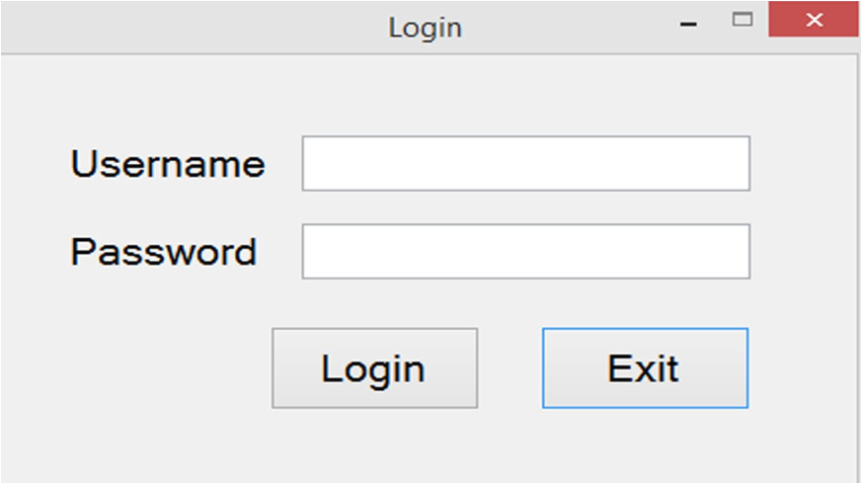
Log in screen
LOG IN PAGE
To Do List
USER TYPE PAGE
SELF REPORTS
EMPLOYEE MENU
MANAGER MENU
SEARCH EXISTING CUSTOMER
OPPORTUNITIES TABLE
REPRICING PRODUCTS
REPORTS
EXISTING CUSTOMER
NEW CUSTOMER
PRICES
NEXT STAGE
PAYMENT
SUMMARY

Slide 3
Employee go to menu Employee
Manager go to manager menu
LOG IN PAGE
To Do List
USER TYPE PAGE
SELF REPORTS
EMPLOYEE MENU
MANAGER MENU
SEARCH EXISTING CUSTOMER
OPPORTUNITIES TABLE
REPRICING PRODUCTS
REPORTS
EXISTING CUSTOMER
NEW CUSTOMER
PRICES
NEXT STAGE
PAYMENT
SUMMARY

Slide 4
MENU – Manager
MANAGER MENU
Opportunity Table
New customer
Reports
Search Existing customer
LOG IN PAGE
To Do List
USER TYPE PAGE
SELF REPORTS
EMPLOYEE MENU
MANAGER MENU
Repricing Products
SEARCH EXISTING CUSTOMER
OPPORTUNITIES TABLE
REPRICING PRODUCTS
REPORTS
EXISTING CUSTOMER
NEW CUSTOMER
PRICES
NEXT STAGE
PAYMENT
SUMMARY

Slide 5
Reports
CHOOSE REPORT
1. SUCCESSFUL DEALS
2. LOST DEALS
3. PENDING DEALS
LOG IN PAGE
To Do List
USER TYPE PAGE
SELF REPORTS
EMPLOYEE MENU
MANAGER MENU
Back to manger Menu
SEARCH EXISTING CUSTOMER
OPPORTUNITIES TABLE
REPRICING PRODUCTS
REPORTS
EXISTING CUSTOMER
NEW CUSTOMER
Back to Employee Menu
PRICES
NEXT STAGE
PAYMENT
SUMMARY

Slide 6
REPRICING PRODUCTS
PRODUCT NAME | CURRENT PRICE | NEW PRICE | CHANGE BY PERCENTAGE
REGULAR STREAMER | 100 | 110/90 | UP/DOWN 10%
HD STREAMER | 120 | 144/108/96 | UP/DOWN 20%
4K STREAMER | 150 | 195/135/120/105 | UP/DOWN 30%
REMOTE CONTROLLER | 20 | 24
VOD | 50 | - | -
SPORT PACKAGE | 50 | - | -
SPORT5 GOLD | 35 | - | -
SPORT5 PLUS | 35 | - | -
MOVIES PACKAGE | 50 | 75 | UP/DOWN 50%
LOG IN PAGE
To Do List
USER TYPE PAGE
SELF REPORTS
EMPLOYEE MENU
MANAGER MENU
SEARCH EXISTING CUSTOMER
OPPORTUNITIES TABLE
REPRICING PRODUCTS
REPORTS
Back to manger Menu
EXISTING CUSTOMER
NEW CUSTOMER
PRICES
NEXT STAGE
PAYMENT
SUMMARY

Slide 7
EMPLOYEE MENU
MENU - Employee
Opportunities table
New customer
To Do List
Self Reports
Search Existing customer
LOG IN PAGE
To Do List
USER TYPE PAGE
SELF REPORTS
EMPLOYEE MENU
MANAGER MENU
SEARCH EXISTING CUSTOMER
OPPORTUNITIES TABLE
REPRICING PRODUCTS
REPORTS
EXISTING CUSTOMER
NEW CUSTOMER
PRICES
NEXT STAGE
PAYMENT
SUMMARY

Slide 8
To do list
closed | Urgency | Status | Date | Costumer Name | Costumer ID | Employee Name | Deal number
NO | 1 | Contact during the day | 18/11/18 | Tal Gal | 51315151 | Dani Tal | 00025
NO | 5 | Contact in a week | 18/11/18 | Dan Moshe | 21031023 | Ron Cohen | 00143
NO | 3 | Contact in a month | 16/11/18 | Daniela Levi | 14521036 | David Levi | 00258
YES | 2 | Forward to bookkeeping | 02/10/18 | Sapir Mashi | 02236596 | Karin Sapir | 00001
NO | 7 | Contact in a week | 03/09/18 | Gal Moyal | 20135415 | Liz Dahan | 00036
YES | 2 | Forward to bookkeeping | 01/09/18 | Liron Ben | 74651321 | Roni Sami | 00047
YES | 2 | Forward to bookkeeping | 01/01/18 | Eden Sapir | 37512365 | Nastia Natali | 03526
NO | 1 | Contact during the day | 29/12/17 | Adi Perez | 32698452 | Lee Yosef | 01200
YES | 2 | Forward to bookkeeping | 25/12/17 | Ofek Afik | 10235641 | Roi Levi | 00223
LOG IN PAGE
To Do List
USER TYPE PAGE
SELF REPORTS
EMPLOYEE MENU
MANAGER MENU
SEARCH EXISTING CUSTOMER
OPPORTUNITIES TABLE
REPRICING PRODUCTS
REPORTS
EXISTING CUSTOMER
NEW CUSTOMER
PRICES
NEXT STAGE
PAYMENT
SUMMARY

Slide 9
Self Reports
Click the type of report you want to generate
Back to manger/employee Menu
1.Employee Report by name
shows:
Report base on employee number
2.All Employee Reports(manager only)
shows:
Report of all employees
3.Statistics(manager only)
shows:
Number of new customers
Number of Existing customers
Number of Potential customers
Profit & Losses (per month / per year)
LOG IN PAGE
To Do List
USER TYPE PAGE
SELF REPORTS
EMPLOYEE MENU
MANAGER MENU
SEARCH EXISTING CUSTOMER
OPPORTUNITIES TABLE
REPRICING PRODUCTS
REPORTS
EXISTING CUSTOMER
NEW CUSTOMER
PRICES
NEXT STAGE
PAYMENT
SUMMARY

Slide 10
Searching Existing customer
Enter ID:
LOG IN PAGE
**Error if ID not found
To Do List
USER TYPE PAGE
SELF REPORTS
EMPLOYEE MENU
MANAGER MENU
Back to manger Menu
SEARCH EXISTING CUSTOMER
OPPORTUNITIES TABLE
REPRICING PRODUCTS
REPORTS
Search
EXISTING CUSTOMER
NEW CUSTOMER
Back to Employee Menu
PRICES
NEXT STAGE
PAYMENT
SUMMARY

Slide 11
Existing customer
City:
Address:
customer Status: Potential / Subscribed
First name:
Last name:
ID:
Phone number:
Email Address:
Israel
John
Doe
Rachamim 136/9
123456789
054-222-55-55
LOG IN PAGE
A@gmail.com
To Do List
USER TYPE PAGE
SELF REPORTS
EMPLOYEE MENU
MANAGER MENU
Edit Deal Details
Edit Customer Details
Back to manger Menu
SEARCH EXISTING CUSTOMER
OPPORTUNITIES TABLE
REPRICING PRODUCTS
REPORTS
EXISTING CUSTOMER
NEW CUSTOMER
Show History
Back to Employee Menu
PRICES
NEXT STAGE
PAYMENT
SUMMARY

Slide 12
Opportunity Table
STATUS | DATE | CLIENT’S NAME | PRICE | PROBABILLITY
PENDING | 22/08/18 | DENIS | 330NIS | 83%
LOST | 24/08/18 | LIZ | 270NIS | 0%
WON | 24/08/18 | MOSHIKO | 500NIS | 100%
LOG IN PAGE
To Do List
USER TYPE PAGE
Back to manger Menu
SELF REPORTS
EMPLOYEE MENU
MANAGER MENU
SEARCH EXISTING CUSTOMER
OPPORTUNITIES TABLE
REPRICING PRODUCTS
REPORTS
Back to Employee Menu
EXISTING CUSTOMER
NEW CUSTOMER
PRICES
NEXT STAGE
PAYMENT
SUMMARY

Slide 13
New customer
City:
Address:
First name:
Last name:
ID:
Phone number:
Email Address:
LOG IN PAGE
To Do List
USER TYPE PAGE
SELF REPORTS
EMPLOYEE MENU
MANAGER MENU
Back to manger Menu
SEARCH EXISTING CUSTOMER
OPPORTUNITIES TABLE
REPRICING PRODUCTS
REPORTS
Next Stage
EXISTING CUSTOMER
NEW CUSTOMER
Back to Employee Menu
PRICES
NEXT STAGE
PAYMENT
SUMMARY

Slide 14
Next Stage
Notes:
Deal Number: 0000001
Type of product: Regular / HD / VOD / Combined
Number of Products:
Type of deal: Regular / Business
Total Price: 124 (According to what we chose)
Deal Status: Won / Lost / Pending (High & Low priority)
LOG IN PAGE
To Do List
USER TYPE PAGE
SELF REPORTS
EMPLOYEE MENU
MANAGER MENU
Confirm
Go to payment
SEARCH EXISTING CUSTOMER
OPPORTUNITIES TABLE
REPRICING PRODUCTS
REPORTS
Back to manger Menu
EXISTING CUSTOMER
NEW CUSTOMER
Save
Back to Employee Menu
To Do List
PRICES
NEXT STAGE
PAYMENT
SUMMARY

Slide 15
Our Prices:
List of items with the price
other companies prices:
List of prices per items
Solutions :
List of options to compete against
LOG IN PAGE
To Do List
USER TYPE PAGE
SELF REPORTS
EMPLOYEE MENU
MANAGER MENU
Back to manger Menu
SEARCH EXISTING CUSTOMER
OPPORTUNITIES TABLE
REPRICING PRODUCTS
REPORTS
EXISTING CUSTOMER
NEW CUSTOMER
Back to Employee Menu
PRICES
NEXT STAGE
PAYMENT
SUMMARY

Slide 16

Type of payment: credit/ cash/ bank statement
According to what we chose -> Go to link
LOG IN PAGE
To Do List
USER TYPE PAGE
SELF REPORTS
EMPLOYEE MENU
MANAGER MENU
Back to manger Menu
SEARCH EXISTING CUSTOMER
OPPORTUNITIES TABLE
REPRICING PRODUCTS
REPORTS
EXISTING CUSTOMER
NEW CUSTOMER
Save & Next
Back to Employee Menu
PRICES
NEXT STAGE
PAYMENT
SUMMARY

Slide 17
Successful Call (1 - 5):
Delivery Date:
Notes for
personal use:
LOG IN PAGE
To Do List
USER TYPE PAGE
SELF REPORTS
EMPLOYEE MENU
MANAGER MENU
SEARCH EXISTING CUSTOMER
OPPORTUNITIES TABLE
REPRICING PRODUCTS
REPORTS
Back to manger Menu
EXISTING CUSTOMER
NEW CUSTOMER
Back to Employee Menu
PRICES
NEXT STAGE
PAYMENT
SUMMARY

